Slide 1

DetroitEatz
Mary Lynn Holmes, Duvon Benon, Kamaljit Chahal,
Shannon Ramelot, Chris Wilson

Slide 2
The Teams

Slide 3
DUVON BENON
FUNCTIONALITY TESTER

Slide 4
Functionality Testing
What is functional testing ?
The testing type that I decided to do was functional testing
Test Scenarios for my test case
Defect Testing
What I learned

Slide 5
SHANNON RAMELOT
DESIGNER
USABILITY TESTER

Slide 6
Usability Testing
Usability Testing - user-friendliness check, application flow, system navigation
Importance of Good Design
Browser Compatibility Test
The User Experience
Goal: Satisfaction of the user with
the entire experience of using the site

Slide 7
KAMALJIT CHAHAL
SECURITY TESTER

Slide 8
Security Testing
OWASP Zed Attack Proxy (ZAP)
Tools do not make the software secure but should form part of a well-balanced application security program. Source code review is the best option.
Focus on the security holes most likely to be found and exploited by an attacker that will lead to the most serious compromises.
Testing of DetroitEatz on Azure App Service did not reveal any significant issues

Slide 9
CHRIS WILSON
AUTOMATED TESTER

Slide 10
Automated Testing
What was important to automate QA Testing
How did I automate QA Testing with Selenium
Issue I encounter with automation DetroitEatz website
Choosing which task to automate or not
Reviewed automation with JUNIT

Slide 11
MARY LYNN HOLMES
PROJECT LEADER

Slide 12
Detroit Eatz Testing
IEEE 829 Standards
Agile Methodology
Testing Methods
Teamwork

Slide 13
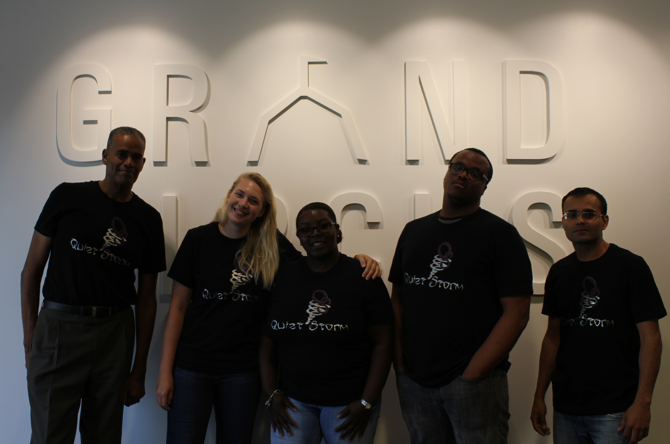
Reflections

Slide 14
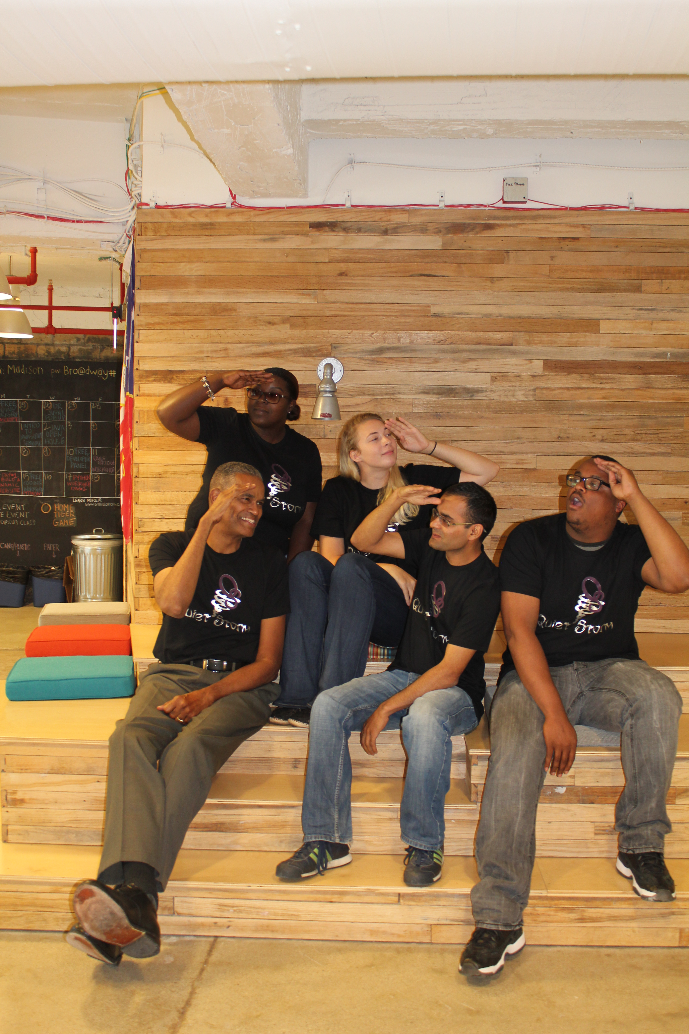
QUESTIONS?

